Slide 4
About Aries Systems
Aries transforms and revolutionizes the delivery of high-value content to the world. We are committed to providing highly customizable, flexible, and innovative workflow solutions designed to help enhance the discovery and dissemination of human knowledge.
Quick Facts:
HQ in North Andover, MA with 100+ global staff
Market leader serving over 8,500 publications including multinational publishers and learned societies
Trusted partner offering dedicated 1:1 customer support
Grounded on our core values: customer centric, quality, curiosity, collaboration, leadership & accountability

Slide 17
Extra Icons

Slide 18
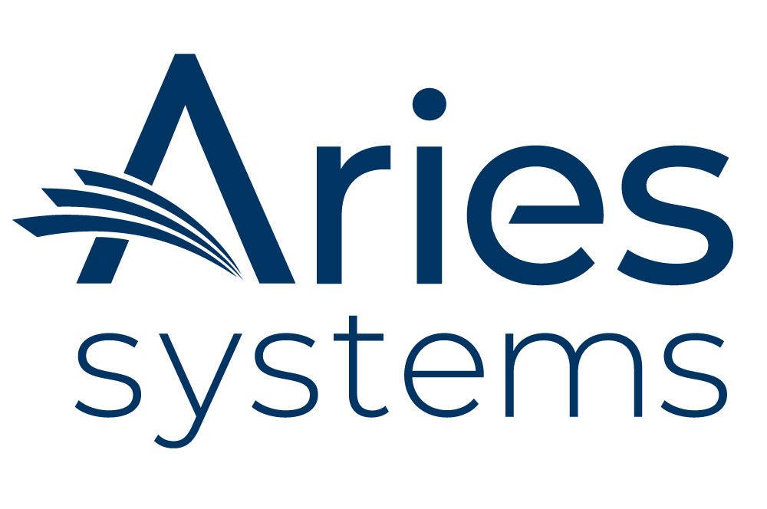



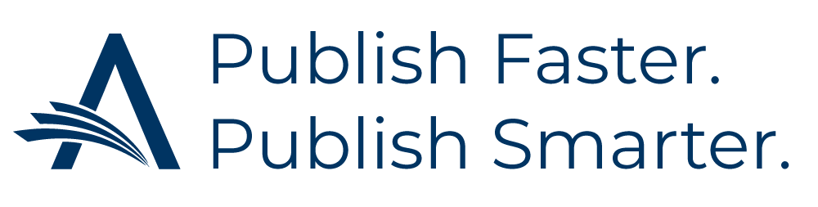
Aries Logos

Slide 19

Watermark

