Slide 4
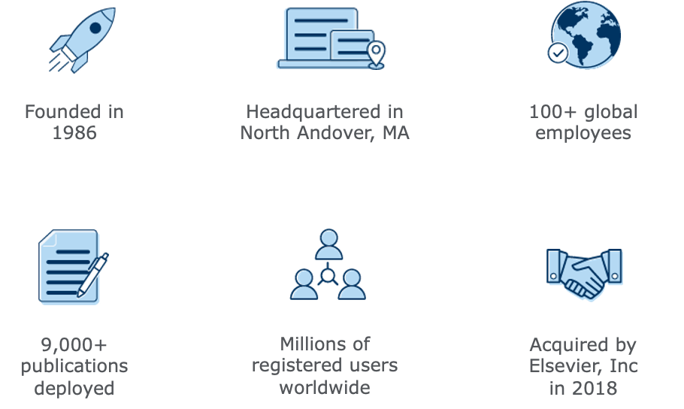
About Aries Systems
Our Mission:
Aries transforms and revolutionizes the delivery of high-value content to the world. We are committed to providing flexible and innovative workflow solutions designed to help enhance the discovery and dissemination of human knowledge.

Slide 17
Extra Icons

Slide 18





Aries Logos

Slide 19


Other Assets

Slide 20

Watermark

