Slide 1
www.ariessys.com

Slide 2
Sales Deck

Slide 3
About Aries Systems
Aries transforms and revolutionizes the delivery of high-value content to the world. We are committed to providing highly customizable, flexible, and innovative workflow solutions designed to help enhance the discovery and dissemination of human knowledge.
Quick Facts:
HQ in North Andover, MA with 100+ global staff
Market leader serving over 8,500 publications including multinational publishers and learned societies
Trusted partner offering dedicated 1:1 customer support
Ground on our core values: customer centric, quality, curiosity, collaboration, leadership & accountability

Slide 4
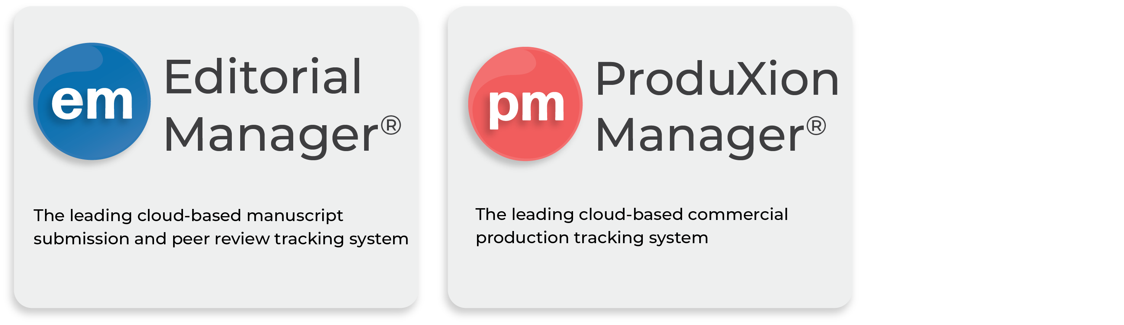
Our Solutions

Slide 5
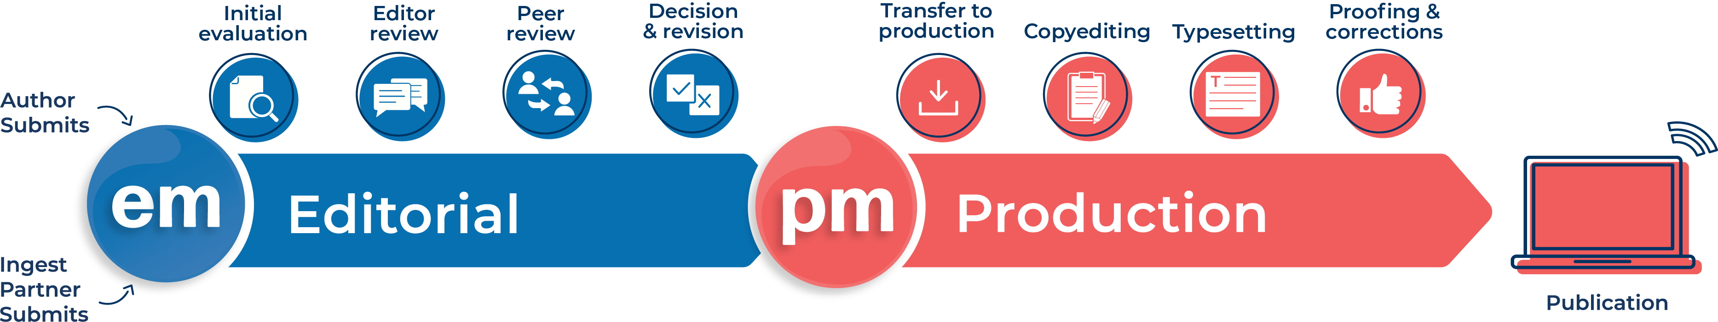
End-to-End Publishing Solution
Manages metadata, files, and other content
Automates workflow tasks with value-add tools
Streamlines communication between all stakeholders

Slide 6
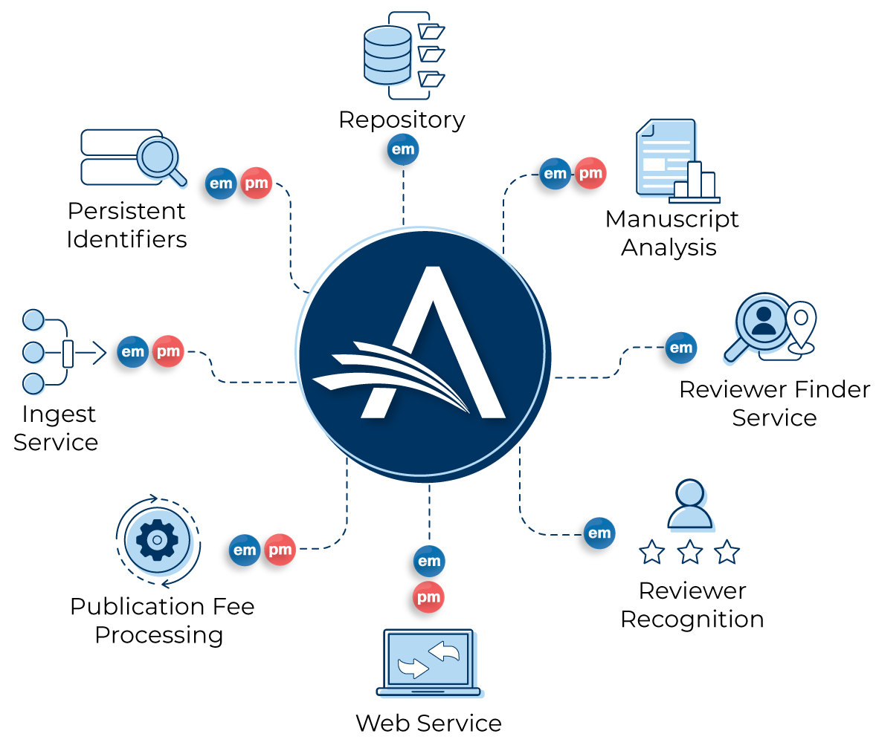
Expansive Ecosystem, Optimized Workflow
Aries Systems’ purpose-built APIs and integrations are designed to connect industry-leading technology with Editorial Manager and ProduXion Manager, providing publishers with best-in-class tools all in one place.

Slide 7
Aries Client Services

Slide 8

Aries Client Services Team
Global support with highly knowledgeable and experienced team members in US, UK, and Germany
Dedicated 1:1 Aries Account Coordinator (AC)
Smooth migration and data transfer from system to system
Update configuration options based on customers’ unique workflows/needs
Thorough training and onboarding
Best-in-class service from
pre-launch through
post-launch and beyond

Slide 9















You’re in Good Company!
Used by thousands of scholarly publications globally

Slide 10
“Working with the Aries staff made the experience of transitioning to a new system a pleasant one.”
- Jackie Perry, Managing Editor
American Society of Civil Engineers
Don’t take our word for it…
“PM provides us the flexibility needed to manage a wide variety of journal workflows and keep pace with new initiatives and industry innovations.”
- Naomi Ullman
Wolters Kluwer Health
“Editorial Manager is a smart tool that makes submission and reviewing tasks more efficient and user friendly.”
- Andrea Dulberger, Editorial Assistant
Cell Press
Hear what our Customers have to say!
“EM makes it easy to see the history of a manuscript and keep all the correspondence in one place.”
- Annie Gering
RTI Press

Slide 11
Let’s Connect: Engaged User Community
Educational and user training webinars
Connect with users though EM/PM independent email listserv.
Semi-annual user group meetings in US and UK
Join us at industry events and conferences.
Aries Systems monthly newsletter
Follow the Aries social media and blog!

Slide 12

Aries User Group Meetings
“This was a great way to immerse myself with your
product and the organization and the support behind it.
I was very impressed both with staff and how engaged
the users are.”
“I enjoyed the various formal and informal opportunities
to problem-solve with Aries staff and other users, and to
talk/hear about larger trends in scholarly publishing that
we all have to deal with.”
“Mixing with other colleagues, tips, feedback sessions, general atmosphere of thinking through systems – I also love how friendly and family-like everyone at EMUG is. You guys are great!”

Slide 13

Why Choose Aries?
Trusted partner and market leader
Flexibility to instantly adapt workflows
Robust reporting suite
Secure cloud hosted platform via AWS, with full GDPR compliance
Dedicated support with personalized, high-quality service.
Committed to continuous improvement— investing over $6m/yr in new innovations

Slide 15

Introduction to
Editorial Manager Ⓡ (EM)

Slide 16

Editorial Manager Overview
The industry leading, cloud-based manuscript submission and peer-review tracking
system for scholarly journals, reference works, books and other publications.
\
  Authors
  Easily submit manuscripts with automated metadata extraction
  Act on revision requests
  Track manuscript status
  Editorial Office/Editors
  Process submissions
  Utilize quality check tools
  Assign and manage Reviewers
  Set final disposition
  Reviewers
  Manage peer review invitations/assignments
  Submit review commentary
  Receive credit via Reviewer Recognition tools

Slide 17
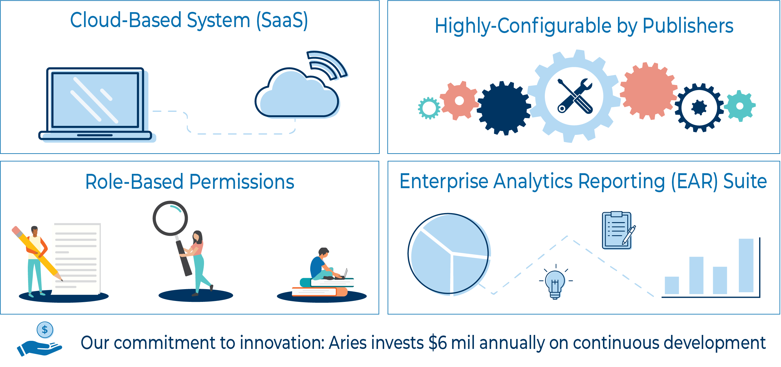
Editorial Manager Basic System Structure

Slide 18
Supporting the Editorial Workflow

Slide 19
Highly Customizable & Flexible System
  Add/Create
  Edit/Modify
User roles
Article types
Submission questions
Registration questions
Unlimited number of automated reminders
Manuscript metadata fields
People metadata fields
Unlimited keywords in tiered hierarchy
… and more!
Article type settings
  (e.g. submission steps, fees,
  # of required reviewers, time
  for reviewer response, etc.)
Text/instructions for Authors and Reviewers
Author, Editor, and Reviewer forms and questions
Manuscript status and final decision terms
Letter templates and automated triggers
User role permissions
… and more!

Slide 20
Xtract for automatic pre-population of submission fields with manuscript metadata
Ingest Service for indirect submission through manuscript preparation tools, preprint servers, etc.
Quality Check and Manuscript Evaluation tools to support Editor decision and improve research output (Similarity Check, Artwork Quality Check, Reference Check, Identity Confidence Check, Technical Check, and more!)
Industry standards for accurate metadata (ORCID®, Ringgold, Crossref Funder Registry, and CRediT)
Single Sign-On (SSO) option for users with ORCID credentials
Fee processing tools to easily manage and process publication charges (APCs)
Editorial Manager
Key Features
and Benefits

Slide 21
Reviewer Search tools to easily identify and invite qualified peer review candidates
Task Manager to complete editorial tasks in parallel and prior to production
Diverse Language Packs for multi-lingual and international publications and global users
Reviewer Recognition tools to offer credit and acknowledgement to Reviewers for their contributions
Seamless transfer of manuscripts and associated data to subsequent journals or production systems
LiXuid Manuscript XML Editor for direct content proofing and editing for simplified production (works with Task Manager only in EM)
Editorial Manager
Key Features
and Benefits

Slide 22

Introduction to
ProduXion Manager Ⓡ (PM)

Slide 23
ProduXion Manager Overview
The leading web based commercial manuscript production tracking system for scholarly journals, reference works, books and other publications.
  Author
  Easily create Author proofs
  Perform status updates
  Editor
  Assign and track tasks
  Transmit files to/communicate with external vendors
  Review and approve proofs
  External Vendors
  Receive and submit production tasks

Slide 24
ProduXion Manager Basic System Structure

Slide 25
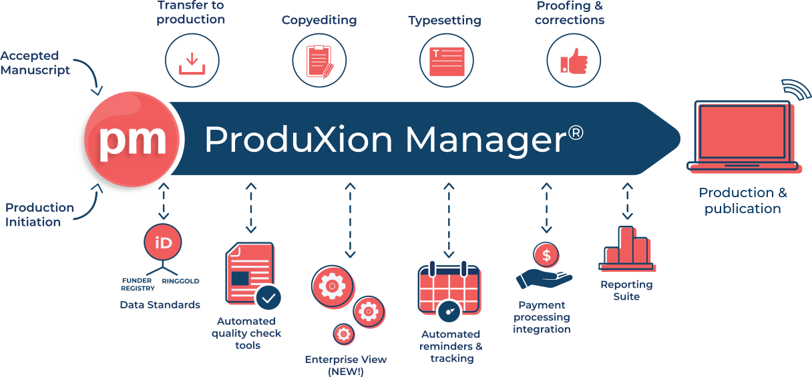
Supporting the Production Workflow

Slide 26
Seamless integration with peer review tracking systems such as Editorial Manager® (EM)
Track task-level scheduled dates to actuals and set automated reminders driven by target publication dates
Issue and article-based workflows and tracking available to support all publication models
Enterprise Analytics Reporting (EAR) offers quick visualization of key data and track KPIs
Enterprise View allows users to access submissions across multiple publications within a single interface
ProduXion Manager
Key Features
and Benefits

Slide 27
Fee processing tools to easily manage and process publication charges (APCs)
XML machine-to-machine transfer of tasks and files to vendors
Export manuscripts and data to downstream systems such as PubMed Central and hosting platforms
Tightly integrated with LiXuid Manuscript™ (LM), Aries’ XML editing tool for simplified and direct proofing
ProduXion Manager
Key Features
and Benefits

Slide 28
LiXuid Manuscript

Slide 29
Introduction to LiXuid Manuscript
  Aries’ Strategic Initiative
  Benefits of XML-First Workflows
  Long-term Vision for LiXuid Manuscript
LiXuid Development Roadmap Status
  Available LiXuid Functionality
  Demo of XML Editor
  LiXuid Functionality in Development
  Future LiXuid Functionality
Questions
Agenda
What we will cover today

Slide 30
Introduction to LiXuid Manuscript
XML Workflows: Aries’ strategic initiative

Slide 31
All About XML
The Importance of XML
Separates document content from format
Uses semantic tagging to structure content
Quicker and more accurate searching of articles
Allows for files to be converted into various formats: HTML, PDF, eBook & more!
The Importance of XML-Early
Metadata and standard identifiers are increasingly critical
PDF metadata not ideal, XML format preferred
Notes:
NOTES FROM LIXUID TEAM:
Publishers understand the importance of XML for published articles because it:
Separates document content from format
Uses semantic tagging to structure content
Quicker and more accurate searching of articles
BUT WHY IS XML BECOMING INCREASINGLY IMPORTANT, AND WHY SHOULD WE WANT IT EARLIER IN THE EDITORIAL PROCESS?
You can’t do much with the metadata in a PDF. (Yes, we can send a PDF to ms evaluation and other AI/ML tools, but far more robust and preferred by the partners to send XML).
Metadata - Personal identifiers (PIDs), Funding Information, Institutional identifiers (Ringgold, ROR, etc.) are increasingly important.
If we have XML early in the editorial process, the submission (XML) can be sent off to AI/ML manuscript evaluation services, etc.

Slide 32
Key Benefits of XML-First Workflows
Streamline
workflow processes
Seamless experience for all stakeholders
Decrease
overall costs
Reduces time
to publication
Higher quality
published research
Improve User
satisfaction
Notes:
NOTES FROM LIXUID TEAM
Streamline workflow processes
All stakeholders are working on the same definitive version of the submission (XML). No more passing annotated PDFs back and forth (download, edit, upload) and version confusion.
Seamless experience for all stakeholders
Same familiar, intuitive user interface (Fonto environment) for authors, reviewers, editors
Seamlessly integrated with EM/PM (user feels like she is still in EM/PM, not being passed off to some other platform).
Higher quality published research
Use ms evaluation tools to determine suitability for journal and other technical checks at time of submission
Peer review commentary is in line and contextually appropriate (think Comment feature in Word), so Editor can make a better/more informed decision.
Author will have more direct feedback on what needs to be corrected.
Overall – each incremental improvement is contributing to better, faster, cheaper research getting out into the world.
Reduces time to publication – Again, each incremental improvement is contributing to faster turn around times.
Decrease overall costs - this is a slippery one because we can’t confidently cite where cost savings will be realized without knowing their workflow. Could just be reduced reliance on/elimination of XML operators/off shore vendors for copyediting and page composition.
Improve Author satisfaction (happiness? Consistent with OKRs or KPOs or something lol).
Their paper gets published faster
Smoother process for proof corrections (today) and revision (future)

Slide 33
Revolutionary XML workflow feature
Works within Aries’ Editorial Manager® and ProduXion Manager®
Includes a suite of tools to streamline workflow
Encompasses Aries’ strategic goal to move XML earlier in the publishing workflow and continue throughout
Multi-year, multi-phase development
LiXuid Manuscript™
What is it?

Slide 34
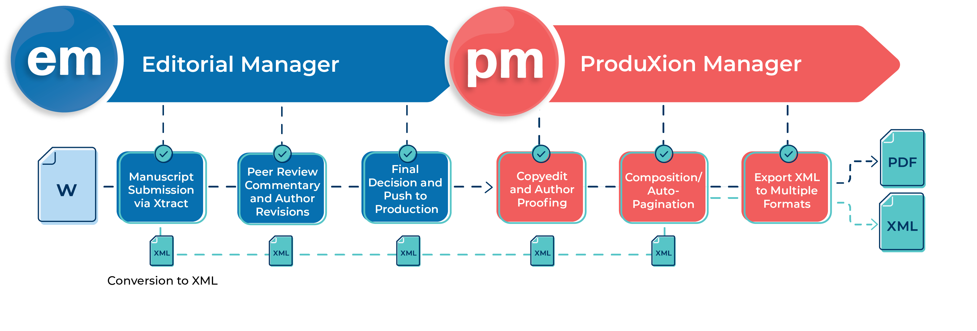
The LiXuid Manuscript Vision
Leverage XML to streamline the entire publishing process
End-to-End XML solution

Slide 35
LiXuid Development
Overview and Status

Slide 36
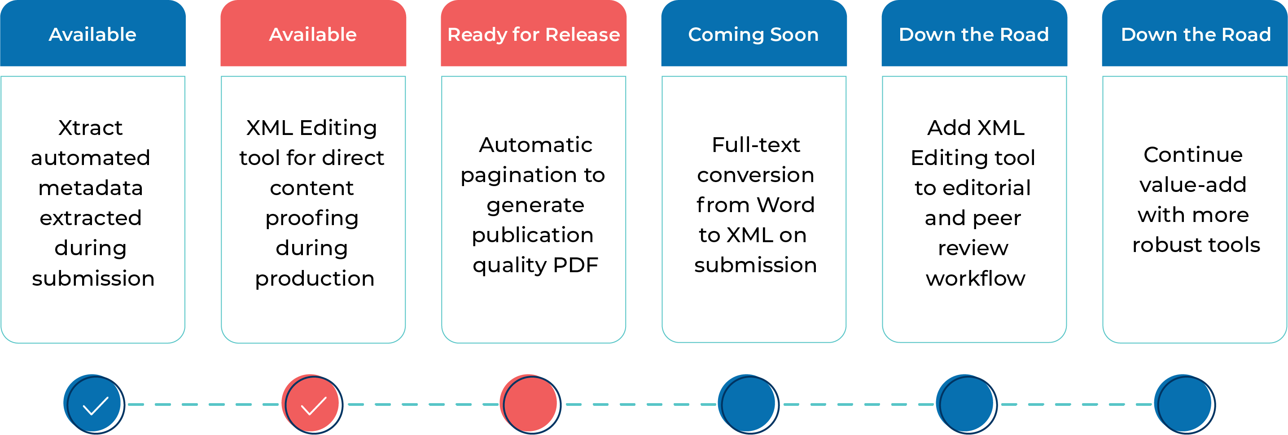
LiXuid Development Timeline
A multi-phase, multi-year initiative

Slide 37

LiXuid Development Timeline
A multi-phase, multi-year initiative

Slide 38
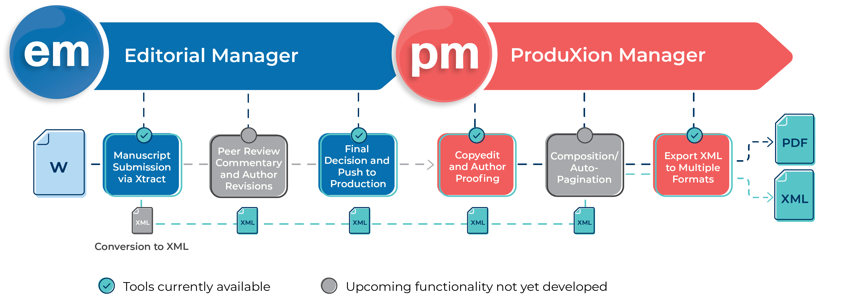
The LiXuid Manuscript Journey

Slide 39
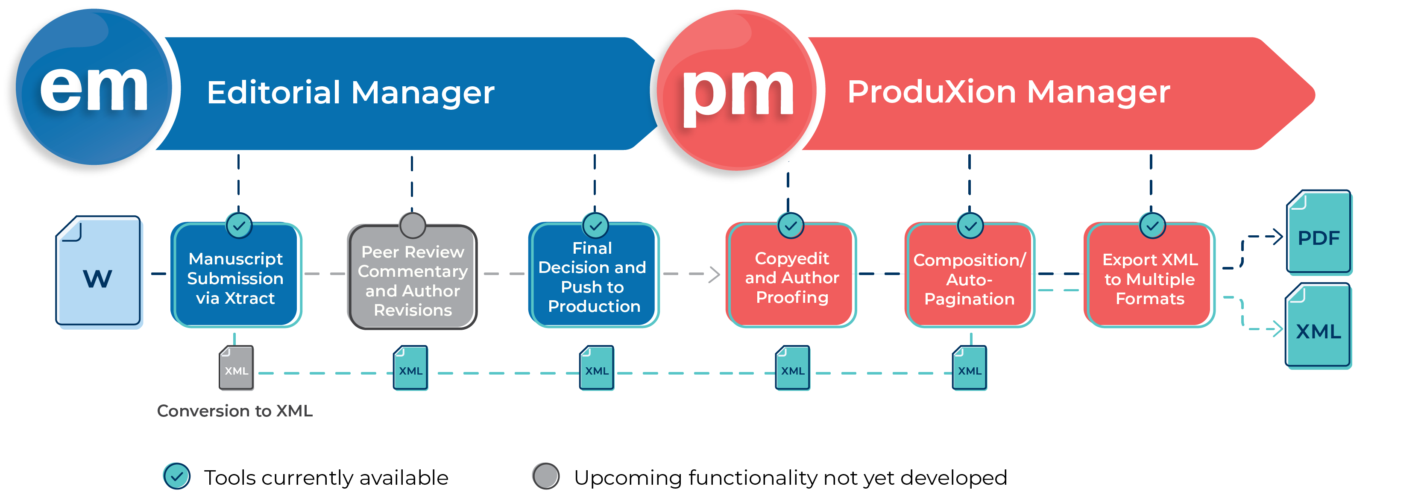
The LiXuid Manuscript Journey

Slide 40
LiXuid Development
Features Available Now!

Slide 41
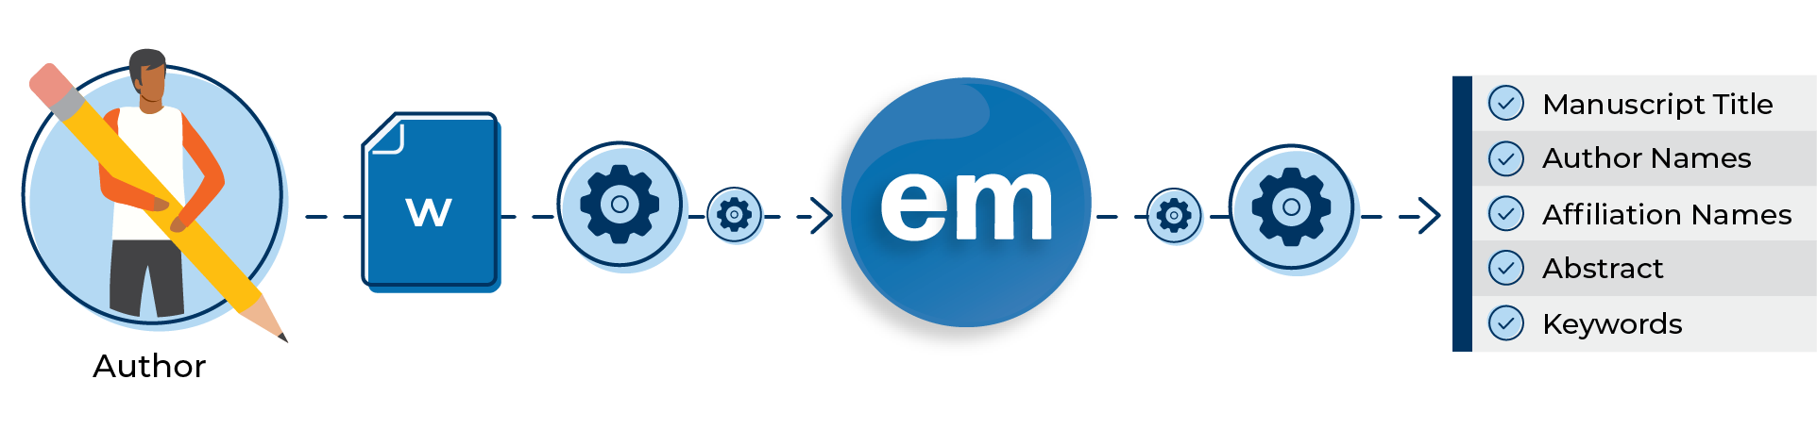
Simplified Manuscript Submission:
Automatically extracts key manuscript metadata
Xtract
Automatically pre-populates submission fields in EM
Intuitive, user-friendly submission interface
Improved Author experience
Streamlining the Submission Process

Slide 42
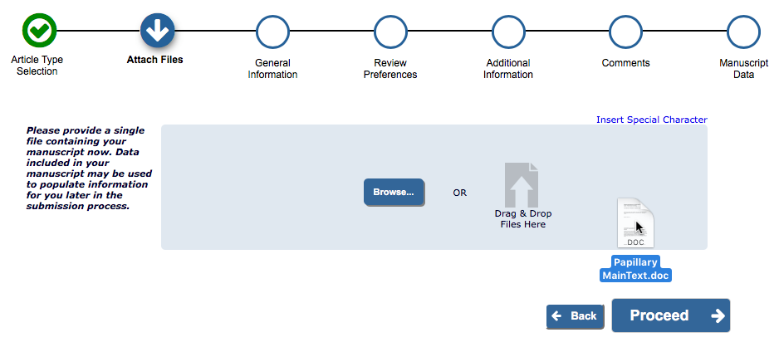
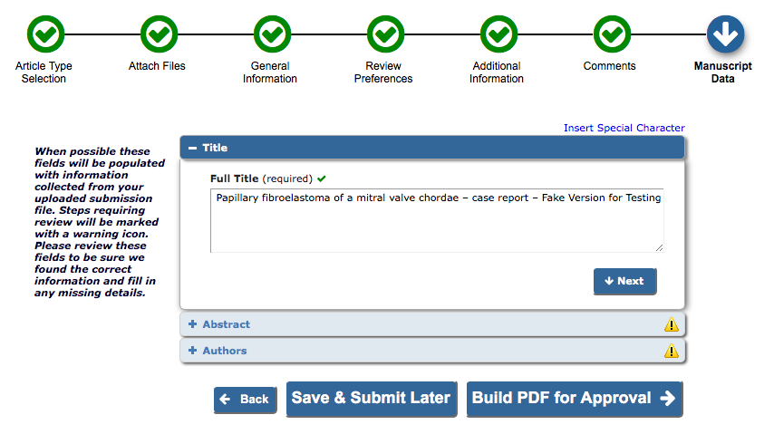
Xtract: Automatic Metadata Extraction
XML conversion proceeds while Author completes other information
Editorial Manager’s (EM) Xtract automatically extracts title, abstract, Author names, affiliations, references and keywords from converted XML and pre-populates submission fields. Author to confirm at the last submission step
Notes:
This should look pretty familiar to you, In 2018 Aries rolled out the Xtract process in author submission to all Editorial Manager sites. It provided an improved submission interface with graphical markers for submission steps.
An author first uploads a manuscript file, and while they complete the other submission steps, Xtract runs in the background, extracting metadata from the manuscript.

Slide 43
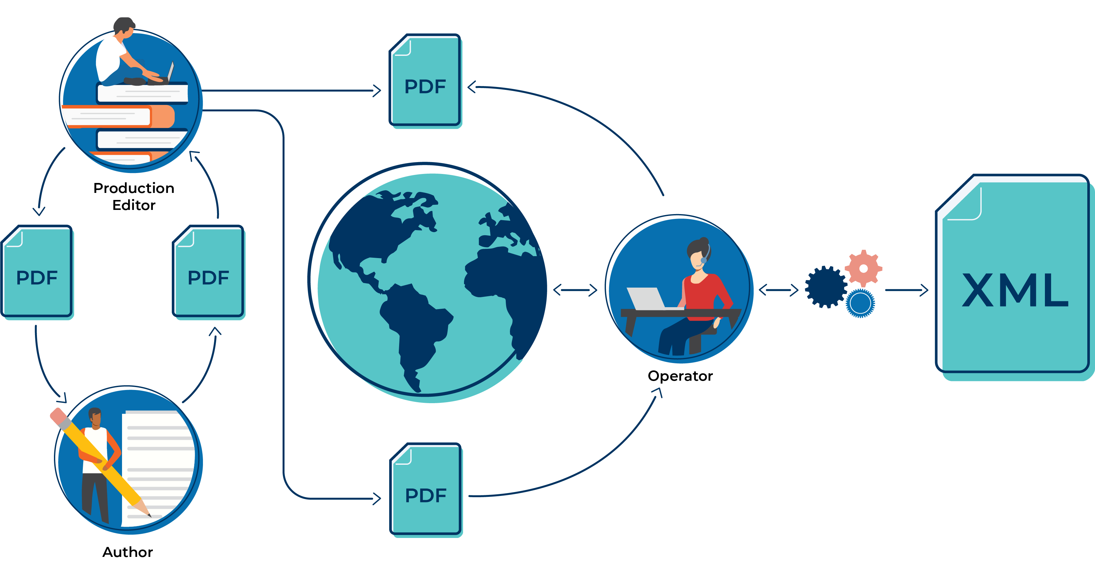
Traditional Production Workflow
Expensive for publishers
XML conversion, formatting, and composition
Results in frustrating delays and confusion

Slide 44
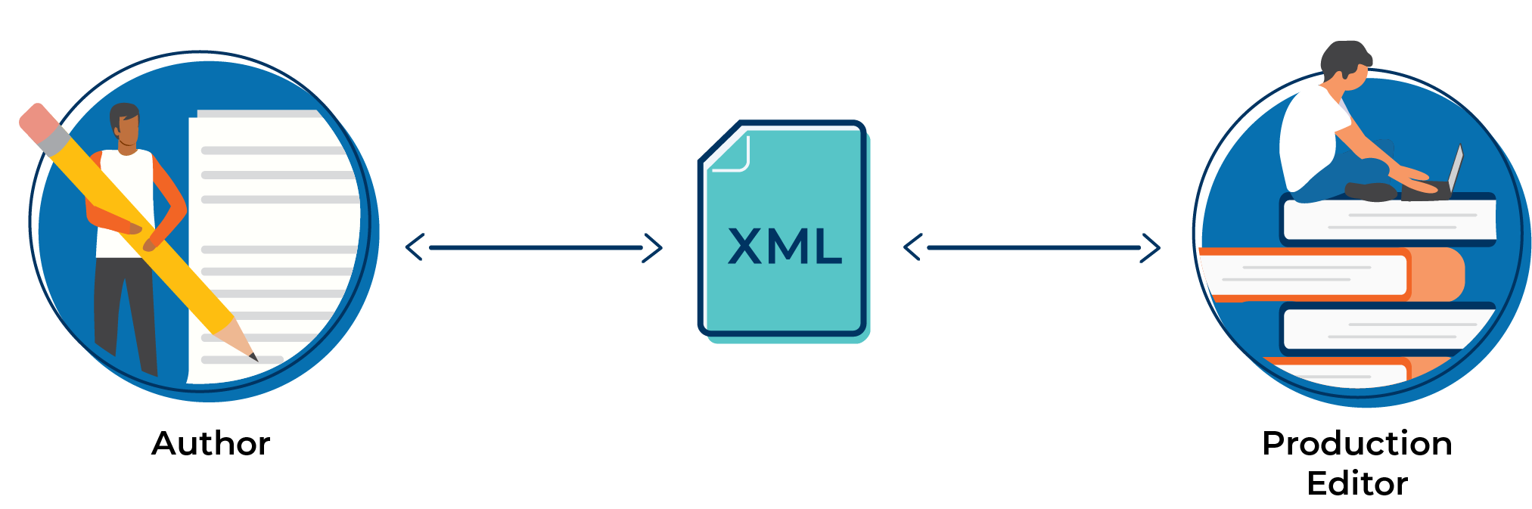
Enhanced Production Workflow
LiXuid Manuscript removes these barriers and streamlines the production workflow

Slide 45


Familiar Word processor-like environment
Intuitive, User-friendly interface
Direct content editing by content experts
Journal style agnostic, Highly customizable
Via integration with Fonto XML
XML Editing Tool
Works within:
Streamlining the Production Process
via Task Manager only

Slide 46
User-friendly for easy editing – no XML
expertise required!
XML Editing Tool
Fewer errors and rounds of edits between copyeditors, Authors and production staff
More efficient workflow: faster turn around time to publication, reduced costs
Workflow Benefits
All edits made to a single document. No confusion as to which one is the “final” version
Improved Author and Editor experience

Slide 47
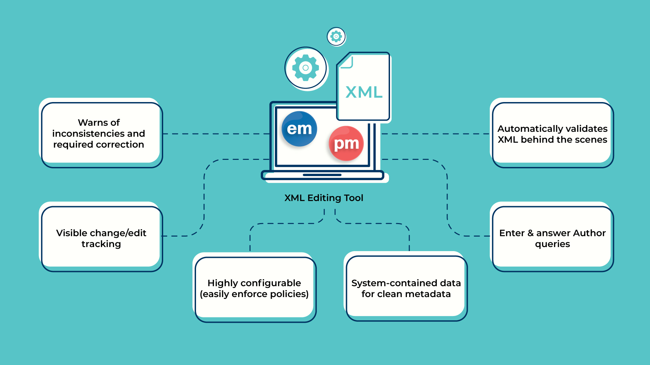

Slide 48
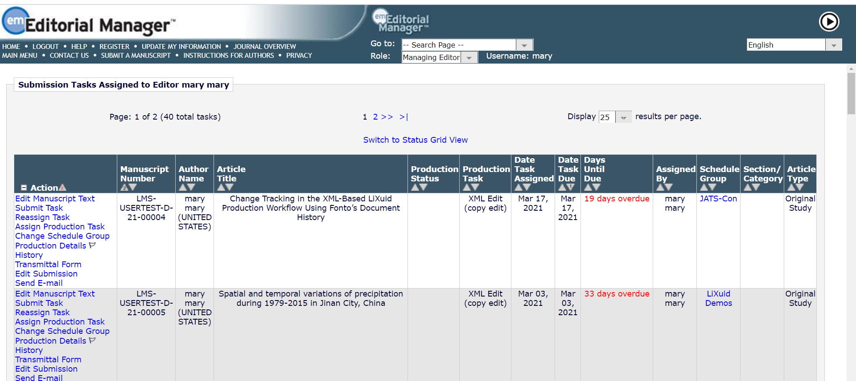
Copyediting via XML Editing Environment
Notes:
We have integrated the Fonto XML Editing tool with EM and PM. Here you can see the ‘Edit Manuscript Text’ link in the Submission Tasks Assigned to Me folder. Clicking it takes the user directly into the XML Editing environment. I know you’ve seen some screenshots but I’m just going to give you a quick high-level tour of the tool.

Slide 49
Quick Tour
LiXuid XML Editor In Action!

Slide 50
Pilot Customer Update
Onboarded EM and PM with LiXuid functionality simultaneously
Very complex content, some non-standard XML tagging practices
UAT performed in March 2021
  Copyeditors of varied experience/comfort level with new technology
  Authors from New Zealand and Venezuela
  1-2 hour sessions with zero training or documentation and virtually no guidance
Notes:
We are currently onboarding Cochrane Review Group.
We wanted to see if users could figure out what they had to do, with no instructions or prior information.

Slide 51
Usability Test Findings
Q: What aspects of the system did you find least intuitive or frustrating?
A: “Search and replace - until I found out how it worked.”
Q: What additional functionality would you like to see added to the LiXuid XML editing tool?
A: “Ability to add and edit references and customizable dictionary for
spell-checking”
Notes:
Overall the feedback was very positive.
Biggest challenge is that we need a near-zero learning curve because Authors will not have any prior training. If you can think back to the first time you used MS Powerpoint or Gmail, it takes a minute to find something but once you’ve found it, you’re good. That was a common theme here.
This exercise has informed what the help and online guidance covers, as well as what the journals will want to include in their instructions and task assignment letters.
Another benefit of working with Fonto is that they are continuing to enhance their product. We met with them just this morning to review the user feedback, and we were pleasantly surprised to learn that a few of our major product enhancement requests were included in the latest release or are on their development roadmap.

Slide 52
LiXuid Development
Coming soon: In the works

Slide 53
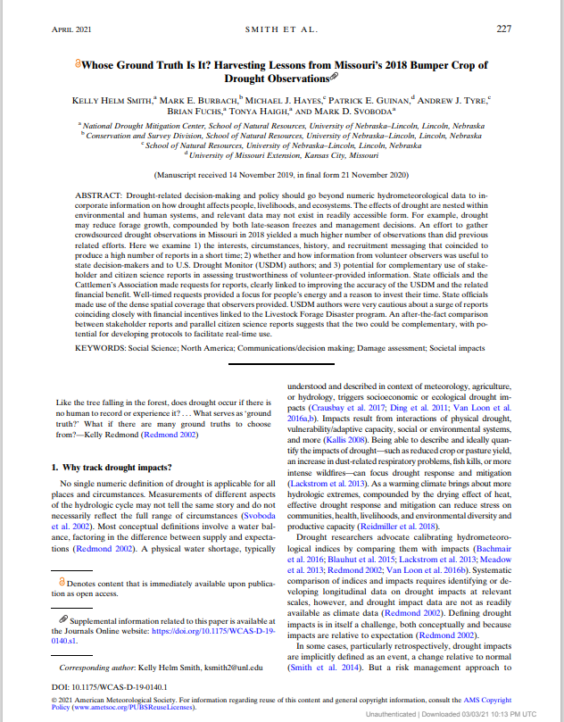
Automatically paginates articles in the journal’s print style from XML and finished graphics
Triggered by a ProduXion Manager production task
Eliminates the need and expense of a typesetter
Packages the PDF, InDesign file, fonts, and graphics into a zip file
Reduces production time
Auto-pagination
via Typefi integration
Notes:
We are integrating the Typefi auto-pagination engine. It is currently in development and planned to be available in late Q2 or early Q3 of this year.
Eliminates the need and cost of a typesetter and reduces TATs - Typefi claims up to 80% faster.
A PM production task triggers the job to create composed PDFs and finished graphic files and package it up for zip file delivery.
STOP
We will work with you to define Typefi workflows which include:
XSLT to transform Aries XML to CXML (the format understood by Typefi and Indesign)
Automated sophisticated layout in InDesign based on your template
Output to PDF – optimized for print or online delivery
Package everything into a zip file for delivery to hosting platform

Slide 54
LiXuid Development
Down the Road: Future Features

Slide 55
Creating a Comprehensive XML Workflow
Full-text of manuscript converted from Word file to structured XML upon submission
Expanding to the Editorial Workflow
Peer review commentary made directly within the system via XML editing tool
Coming up on the
LiXuid Roadmap
Quality checks and Author revisions made directly within the system during editorial workflow (EM) via XML editing tool

Slide 56
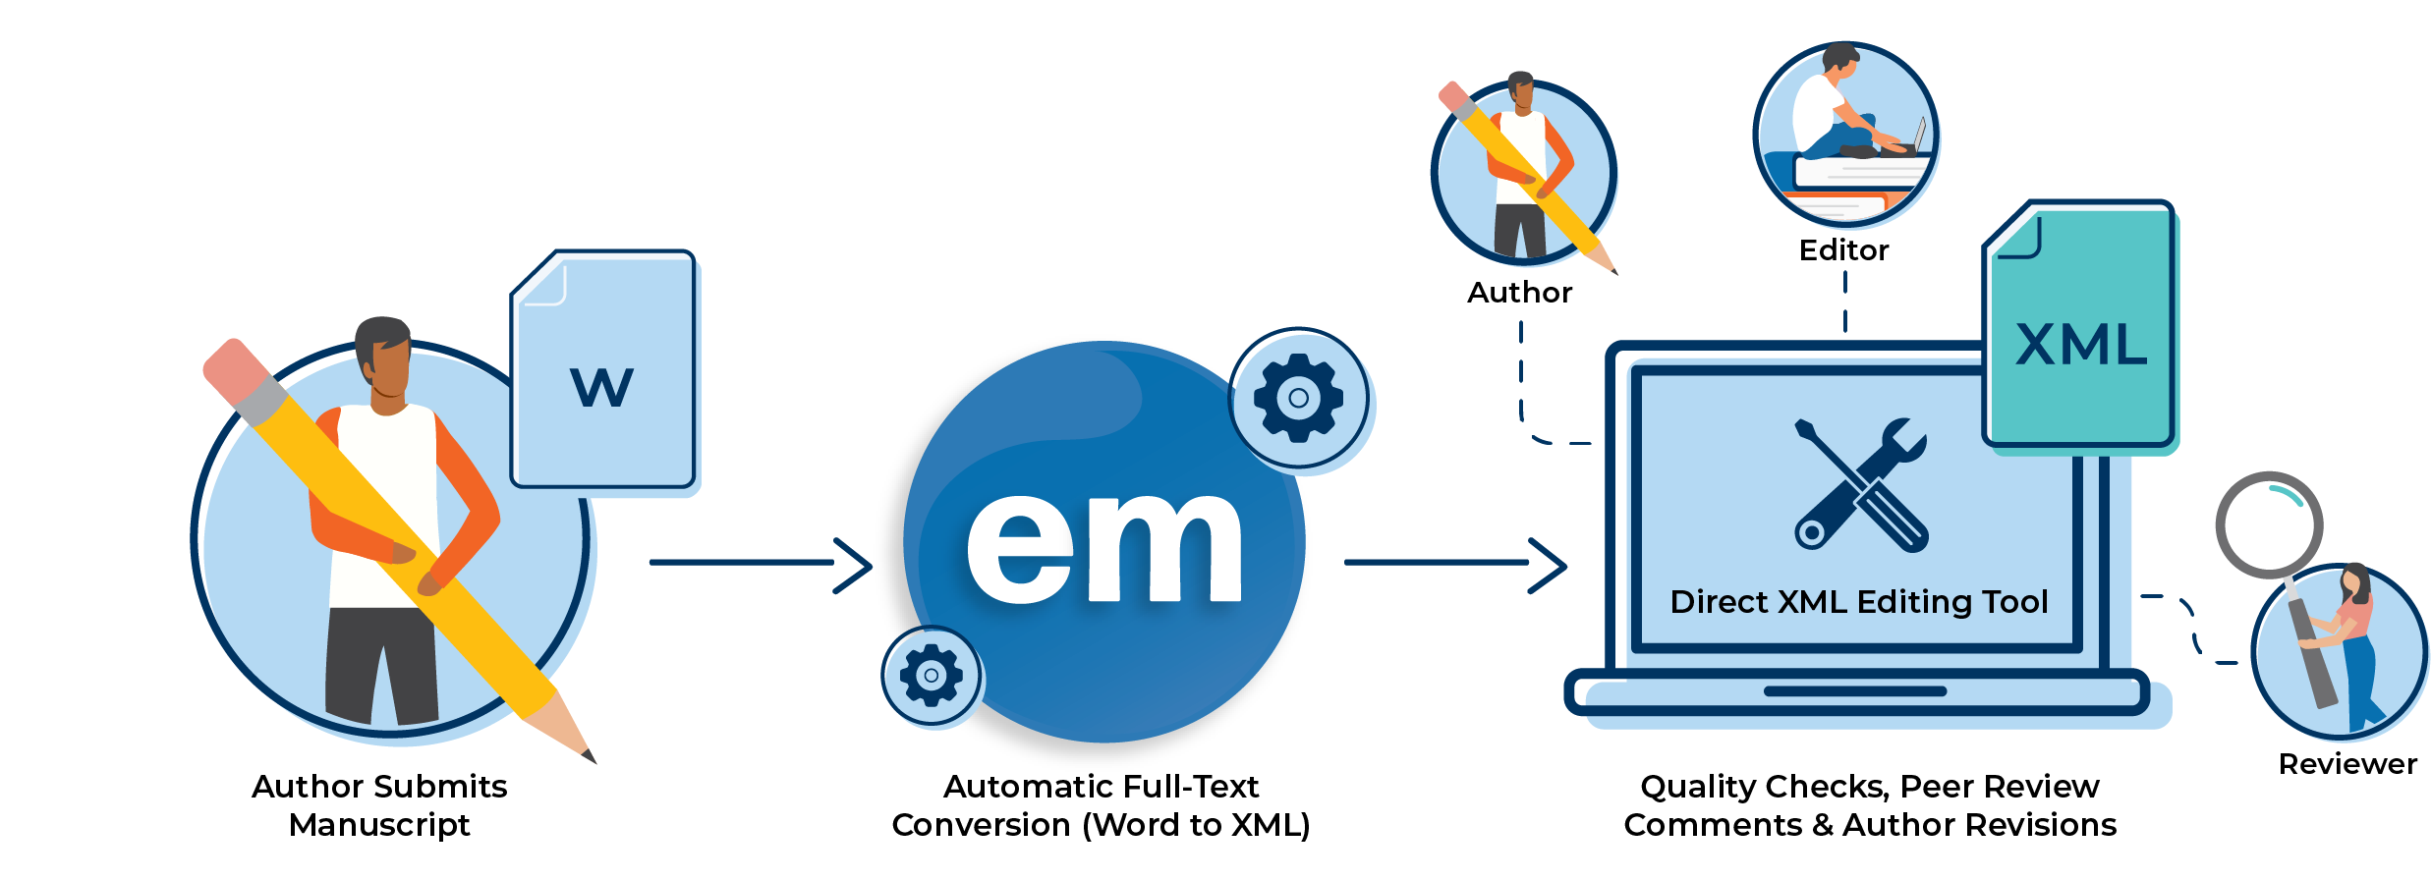
Full-text Conversion (Word -> XML)
Structured text in JATS XML from the start
Apply AI to assist in manuscript enrichment and quality checks
Apply AI to assist in Editor evaluation
Capture Peer-Review commentary in XML without sending PDF revisions around
Revision process refines live text via Editorial Manager XML Editor
Accepted text is available immediately
Notes:
So we know that most, if not all, publishers generate XML at some point in the production process, which is what sits under the hood for LiXuid tools like the XML editor and auto-pagination after a paper has been accepted for publication.
But, if we can generate full text XML around time of submission, there are so many possibilities for services that we can offer. The submission can be sent off to manuscript quality tools like scite.ai (Smart Citation looks at citations and indicates whether the cited article provides supporting or contradictory evidence) or unsilo (technical checks).
Reviewers can conduct peer review commentary in the same XML editing environment that authors and production editors are familiar with, also seamlessly integrated with EM. This is easily extended to the revision process would also be supported in this XML environment, once again the same UI that authors are becoming familiar with and totally integrated with EM/PM.
Both the review commentary and revision edits are captured contextually in the document, which is so much better than trying to align comments made in PDFs or in Word where maybe the author forgot to turn track changes on, and so on.

Slide 57
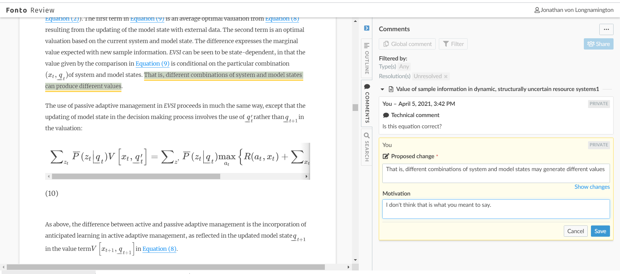
Review and comment directly in the online editing tool
Better user experience for Reviewers and Editors
Comments are all tracked contextually
Reduces turnaround time and errors with peer review
Enables reviewer and editor comments initially, then later authors may also do revisions in XML editor
We have already started requirements analysis for MVP/pilot
Peer review commentary
via interface using HTML display/XML underneath
Notes:
We’ve started exploring what the integration would look like between EM and the review commentary in the Fonto Review module.
We envision the Reviewer Questionnaire and other functionality residing in EM but the Reviewer would simply click a link from the Submit Recommendation page to enter the review commentary environment, review and comment on the manuscript, and upon saving return back to EM where they can submit their full review.
This is virtually the same UI as the XML editing environment, but the submission is “locked down” and cannot be edited. Instead, Reviewers are commenting either generally on the paper or select text or figures or whatever and make suggestions and comments.
The editor can review the comments and choose whether or not to make the proposed changes.
The editor can also review the comments and the original text that the comment was made.

Slide 58
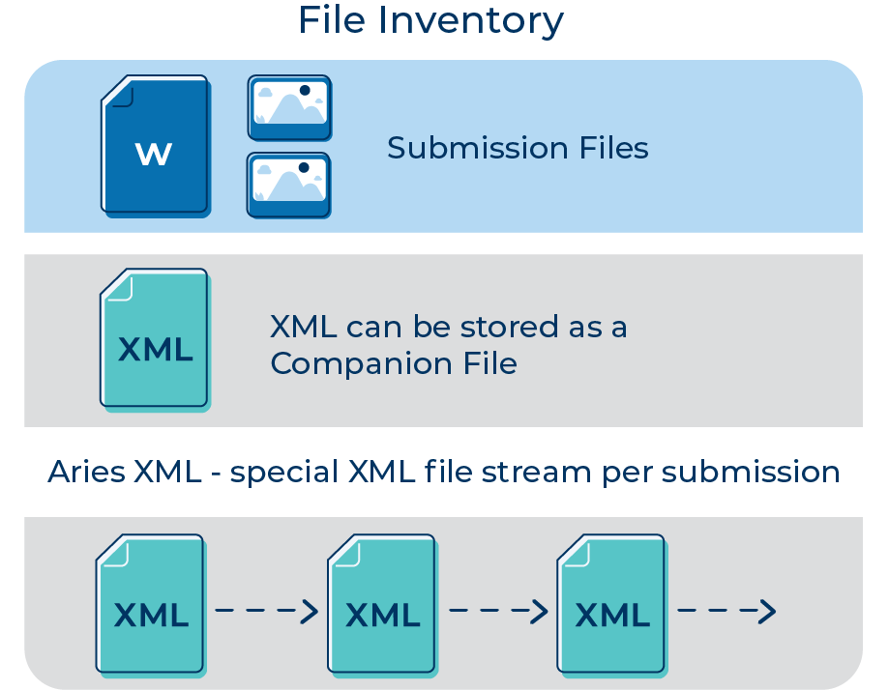
Aries XML
Historically, publisher XML Files are treated as Companion Files
Now, LiXuid Manuscript adds new ‘Aries XML’ (definitive) file stream
Specific XML format (Subset of JATS DTD)
  Tighter version of XML
  Conforms to industry standards
LiXuid Manuscript tools expect a consistent format
Notes:
NOTES FROM LIXUID TEAM
The tools we provide (Fonto editor now, full text conversion/peer review/revise later) give users a user-friendly way to do their work and progress the submission through the workflow, without any knowledge or even clue about XML.
Users cannot “break” (invalidate) the XML because our tools (Fonto) prevents them from doing so. Every edit they make in the Fonto UI results in a change to the underlying XML, automatically updating the structure/tagging behind the scenes.
Aries XML is:
Subset of JATS DTD (Why? JATS is very loose and allows lots of variation in tagging. In order for us to build tools (Fonto) to sit on top of the XML, it needs to be tighter. Eg, JATS allows 16 different ways to associate affiliations with authors. It would be complex and expensive for our editing tool to know how to handle all 16 ways, so we strip it down to 1 way.
Compliant with JATS4R (JATS for Reuse) and PMC (PubMed Central)

Slide 59
Questions?

Slide 61
Extra Icons

Slide 62





Aries Logos

